Slide 1
Chapter 1
Introduction to Hadoop

Slide 2
Contents
What is Hadoop?
Core Hadoop Components
Hadoop Ecosystem
Physical Architecture
Hadoop limitations

Slide 3
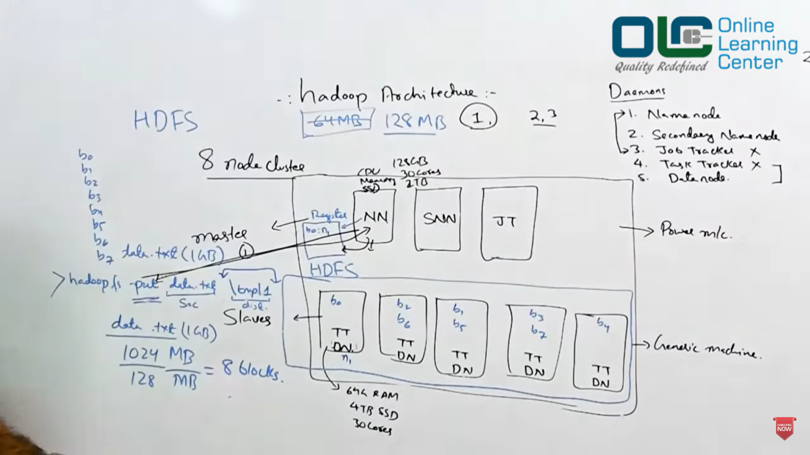

Slide 4
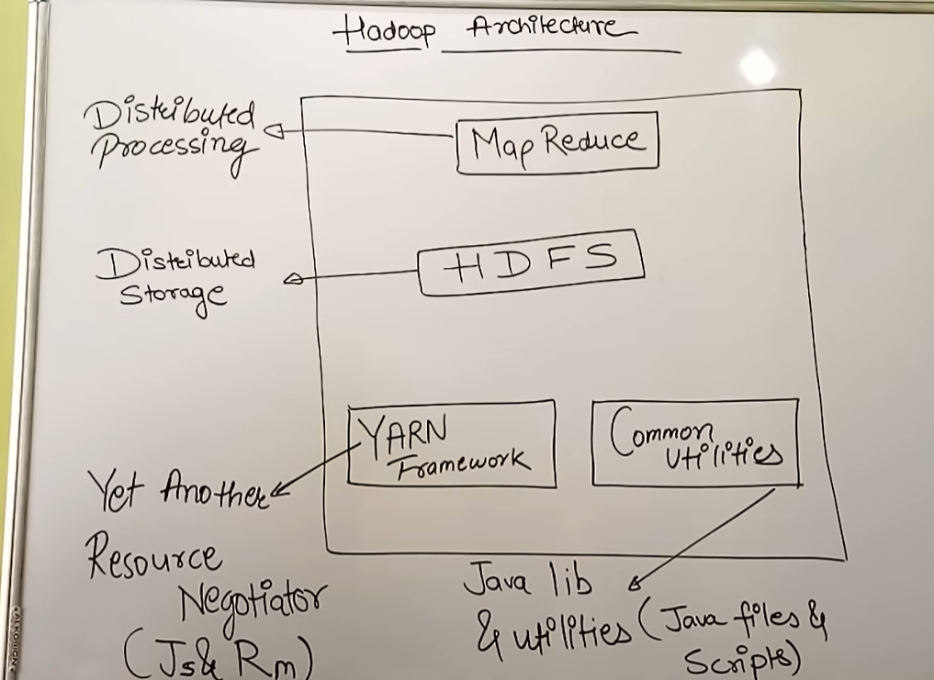

Slide 5
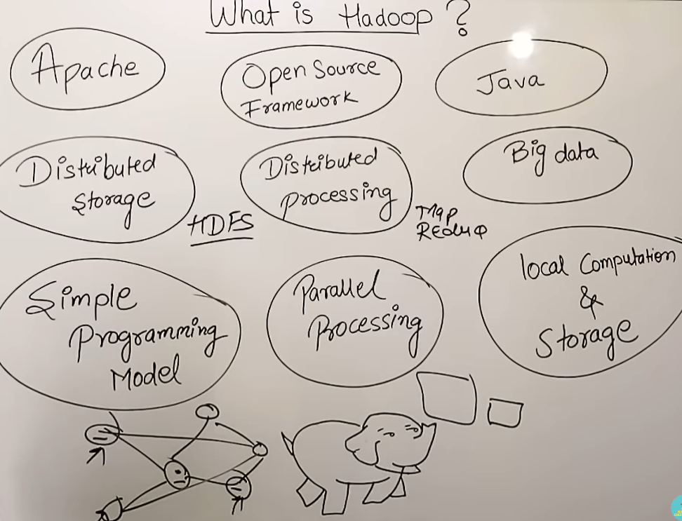

Slide 6
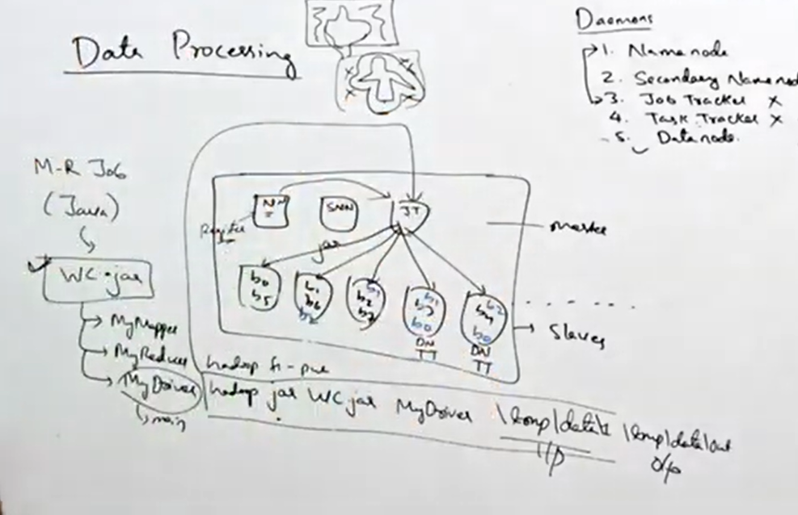
https://www.onlinelearningcenter.in/course-details/hadoop-fundamentals-i

Slide 7
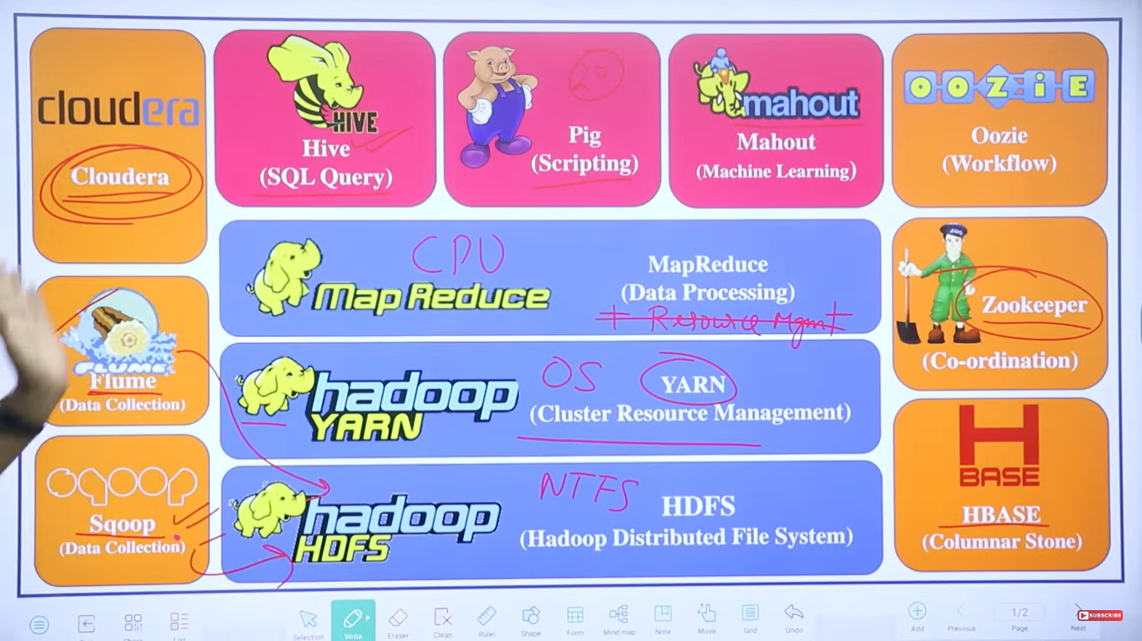
https://www.youtube.com/watch?v=8r7kHT4K1pA

Slide 8
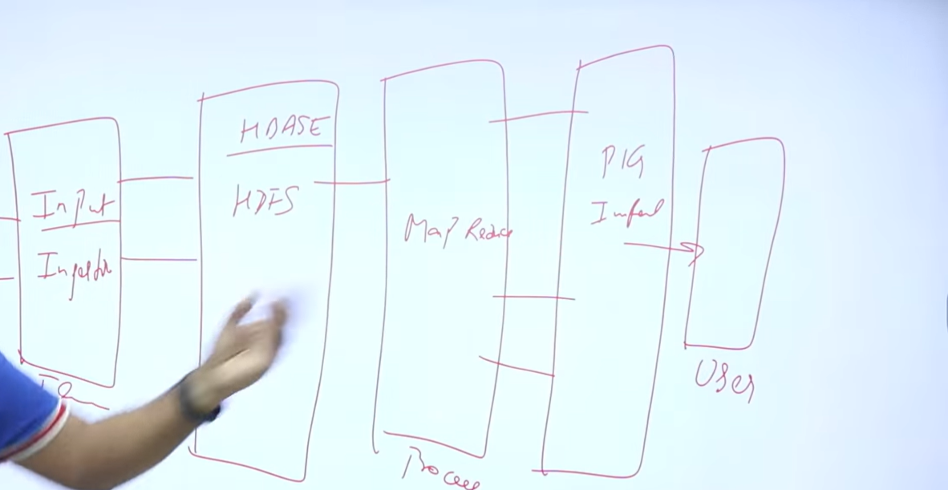

Slide 9
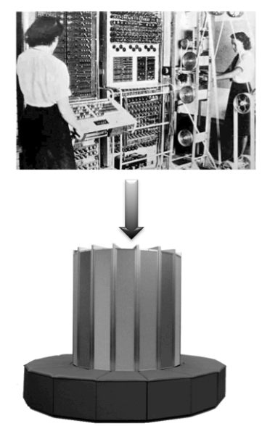
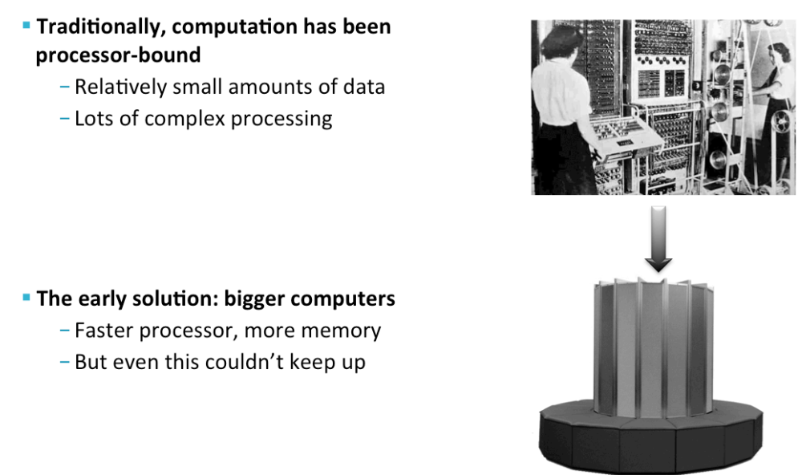
Problems with traditional Large scale Systems
Traditionally, computation has been processor bound
Relatively small amount of data
Lots of complex processing
The early solution: bigger computers
Faster processor, more memory
But even this couldn’t keep up

Slide 10
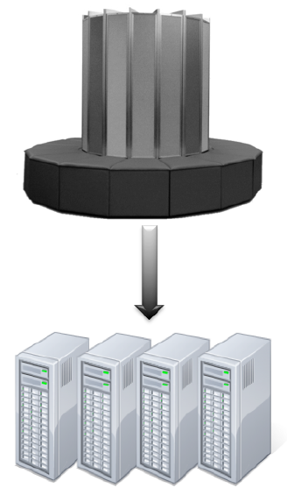
Distributed Systems
The better solution: more computers
Distributed systems -use multiple machines for a single job

Slide 11
Challenges with Distributed Systems
Challenges with Distributed Systems
Programming complexity
Keeping data and processes in sync
Finite bandwidth
Partial failures
The solution?
Hadoop !

Slide 12



Hadoop’s Developers
2005: Doug Cutting and Michael J. Cafarella developed Hadoop to support distribution for the Nutch search engine project.
The project was funded by Yahoo.
2006: Yahoo gave the project to Apache Software Foundation.

Slide 13
What is Hadoop ?
It is Apache’s open source software framework for storing, processing and analyzing big data on cluster of commodity hardware.
Designed to answer the question: “How to process big data with reasonable cost and time?”

Slide 14
https://www.youtube.com/watch?v=8r7kHT4K1pA

Slide 15
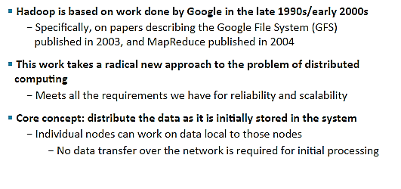
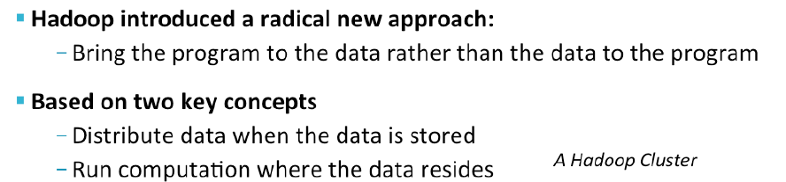
Brief History of Hadoop

Slide 16
Hadoop: Assumptions
It is written with large clusters of computers in mind and is built around the following assumptions:
Hardware will fail.
Processing will be run in batches. Thus there is an emphasis on high throughput as opposed to low latency.
Applications that run on HDFS have large data sets. A typical file in HDFS is gigabytes to terabytes in size.
It should provide high aggregate data bandwidth and scale to hundreds of nodes in a single cluster. It should support tens of millions of files in a single instance.
Applications need a write-once-read-many access model.
Moving Computation is Cheaper than Moving Data.

Slide 17
Hadoop
Hadoop enables computing solution that is
Scalable– New nodes can be added as needed,
and added without needing to change data
formats, how data is loaded, how jobs are
written, or the applications on top.
Cost effective– Hadoop brings massively
parallel computing to commodity servers.
The result is a sizeable decrease in the
cost per terabyte of storage, which in turn
makes it affordable to model all your data.

Slide 18
Flexible– Hadoop is schema-less, and can
absorb any type of data, structured or not,
from any number of sources. Data from multiple
sources can be joined and aggregated in
arbitrary ways enabling deeper analyses than
any one system can provide.
Fault tolerant– When you lose a node, the
system redirects work to another location of
the data and continues processing without
missing a fright beat .

Slide 19

Who uses Hadoop?
Notes:
A9.com – Amazon: To build Amazon's product search indices; process millions of sessions daily for analytics, using both the Java and streaming APIs; clusters vary from 1 to 100 nodes.
Yahoo! : More than 100,000 CPUs in ~20,000 computers running Hadoop; biggest cluster: 2000 nodes (2*4cpu boxes with 4TB disk each); used to support research for Ad Systems and Web Search
AOL : Used for a variety of things ranging from statistics generation to running advanced algorithms for doing behavioral analysis and targeting; cluster size is 50 machines, Intel Xeon, dual processors, dual core, each with 16GB Ram and 800 GB hard-disk giving us a total of 37 TB HDFS capacity.
Facebook: To store copies of internal log and dimension data sources and use it as a source for reporting/analytics and machine learning; 320 machine cluster with 2,560 cores and about 1.3 PB raw storage;
FOX Interactive Media : 3 X 20 machine cluster (8 cores/machine, 2TB/machine storage) ; 10 machine cluster (8 cores/machine, 1TB/machine storage); Used for log analysis, data mining and machine learning
University of Nebraska Lincoln: one medium-sized Hadoop cluster (200TB) to store and serve physics data;
‹#›

Slide 20
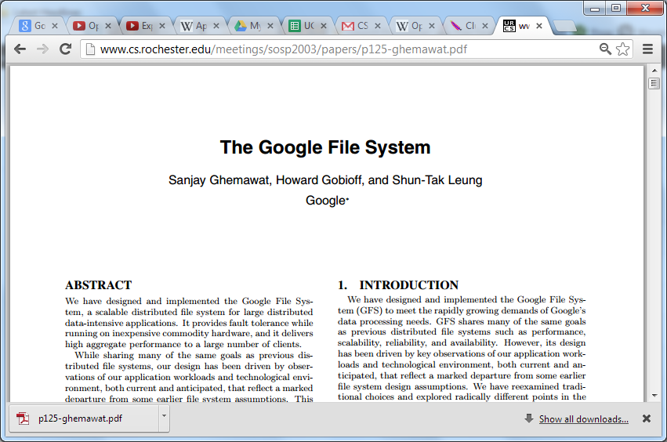

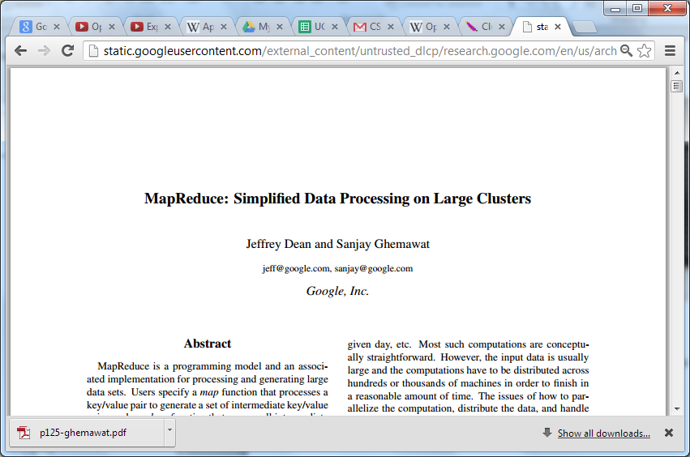

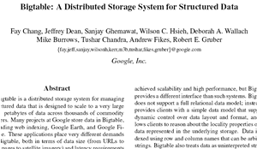


Google Origins
2003
2004
2006

Slide 21
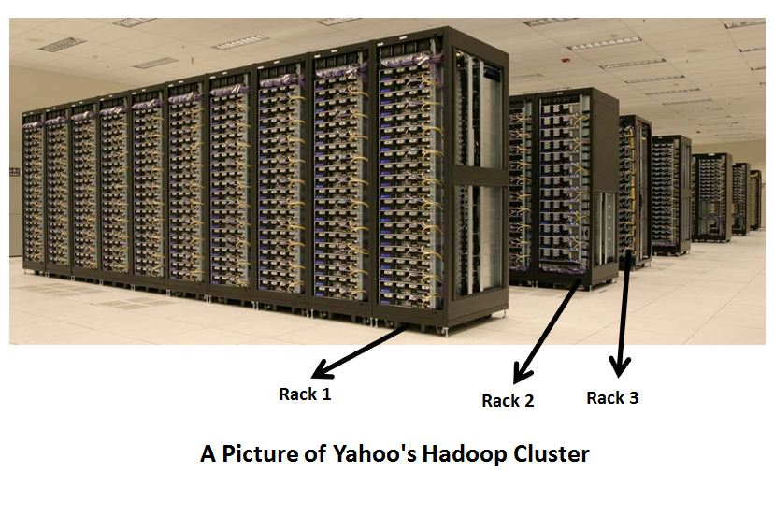
A real Picture of Hadoop Clusters

Slide 22

Hadoop Ecosystem
Hue
(Web Console)
Mahout
(Data Mining)
Oozie
(Job Workflow & Scheduling)
Sqoop
(Data integration)
Pig/Hive (Analytical Language)
Hbase
(Column NoSQL DB)
Zookeeper
(Coordination)
Flume
(Data integration)
MapReduce Runtime
(Dist. Programming Framework)
Hadoop Distributed File System (HDFS)
Notes:
‹#›

Slide 23
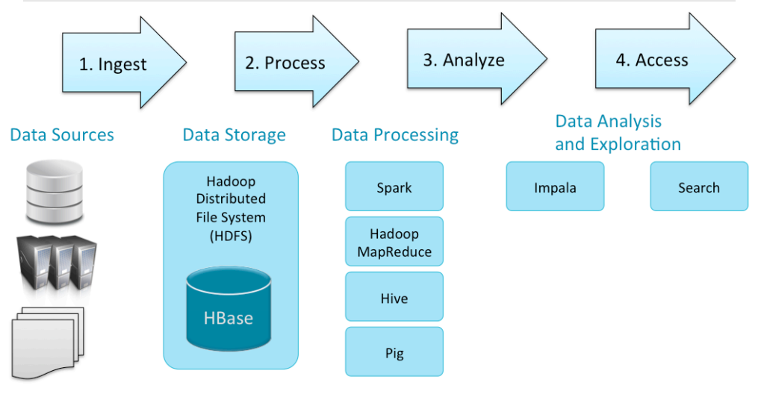
Big data processing in Hadoop

Slide 24
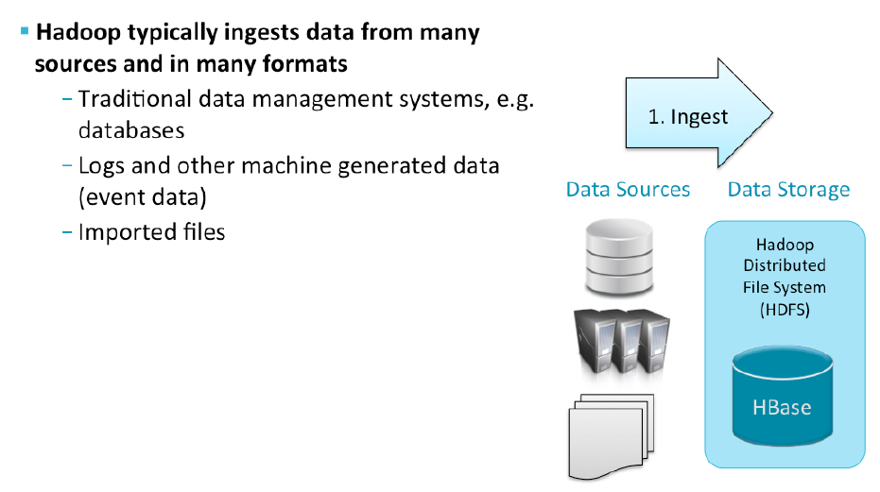
Data Ingest & Storage

Slide 25

Data Storage: HDFS
Hadoop Distributed File System is the core component.
HDFS stores different types of large data sets (i.e. structured, unstructured and semi structured data).
It helps us in storing our data across various nodes and maintaining the log file about the stored data (metadata).
HDFS has two core components, i.e. NameNode and DataNode
The NameNode is the main node and it doesn’t store the actual data. It contains metadata, just like a log file Therefore, it requires less storage and high computational resources.
All your data is stored on the DataNodes and hence it requires more storage resources. These DataNodes are commodity hardware (like your laptops and desktops).That’s the reason, why Hadoop solutions are very cost effective.
You always communicate to the NameNode while writing the data. Then, it internally sends a request to the client to store and replicate data on various DataNodes.

Slide 26

Data Storage:HBase
HBase is an open source, non-relational distributed database (NoSQL database).
It supports all types of data and that is why, it’s capable of handling anything and everything inside a Hadoop ecosystem.
The HBase was designed to run on top of HDFS and provides BigTable like capabilities.
The HBase is written in Java,

Slide 27
Data Storage :HBase
For better understanding, let us take an example.
You have billions of customer emails and you need to find out the number of customers who has used the word complaint in their emails.
The request needs to be processed quickly (i.e. at real time). So, here we are handling a large data set while retrieving a small amount of data.
For solving these kind of problems, HBase was designed.

Slide 28
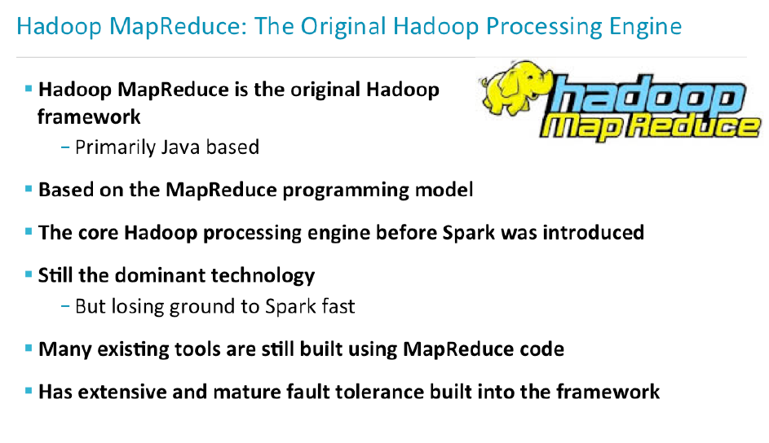
Data Processing: using Map Reduce
MapReduce is a core component of Hadoop Ecosystem.
It is a software framework which processes large data sets using distributed and parallel algorithms.
In a MapReduce program, Map() and Reduce() are two functions.
The Map function performs actions like filtering, grouping and sorting.
While Reduce function aggregates and summarizes the result produced by map function.
The result generated by the Map function is a key value pair (K, V) which acts as the input for Reduce function.

Slide 29

Apache PIG
PIG has two parts:
Pig Latin, the language and
the pig runtime, for the execution environment.
You can better understand it as Java and JVM.
It supports pig Latin language, which has SQL like command structure.
10 line of pig Latin = approx. 200 lines of Map-Reduce Java code.
The compiler internally converts pig Latin to MapReduce.
It produces a sequential set of MapReduce jobs.
PIG was initially developed by Yahoo.
It gives you a platform for building data flow for ETL (Extract, Transform and Load), processing and analyzing huge data sets.

Slide 30
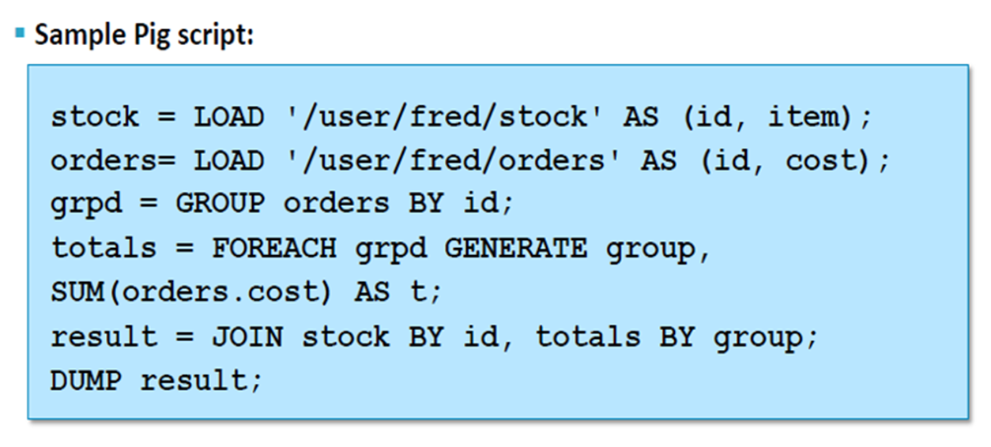
Apache PIG
How PIG works ?
In PIG, first the load command, loads the data.
Then we perform various functions on it like grouping, filtering, joining, sorting, etc.
At last, either you can dump the data on the screen or you can store the result back in HDFS.

Slide 31

Apache HIVE
Facebook created HIVE for people who are fluent with SQL.
HIVE is a data warehousing component which performs reading, writing and managing large data sets in a distributed environment using SQL-like interface.
HIVE + SQL = HQL
The query language of Hive is called Hive Query Language(HQL), which is very similar like SQL.
It has 2 basic components: Hive Command Line and JDBC/ODBC driver.
The Hive Command line interface is used to execute HQL commands.
While, Java Database Connectivity (JDBC) and Object Database Connectivity (ODBC) is used to establish connection from data storage.
Hive is highly scalable. As, it can serve both the purposes, i.e. large data set processing (i.e. Batch query processing) and real time processing (i.e. Interactive query processing).

Slide 32
Hive vs. Pig
S.No. | Apache PiG | Apache Hive
1 | Apache Pig uses a language called Pig Latin. It was originally created at Yahoo. | Hive uses a language called HiveQL. It was originally created at Facebook.
2 | Pig Latin is a data flow language. | HiveQL is a query processing language.
3 | Pig Latin is a procedural language and it fits in pipeline paradigm. | HiveQL is a declarative language.
4 | Apache Pig can handle structured, unstructured, and semi-structured data. | Hive is mostly for structured data.

Slide 33

Apache MAHOUT
Apache Mahout is a library of scalable machine-learning algorithms, implemented on top of Apache Hadoop.
What Mahout does?
Introduction to apache mahout
It performs collaborative filtering, clustering and classification. Some people also consider frequent item set missing as Mahout’s function.
Collaborative filtering: mines user behavior and makes product recommendations (e.g. Amazon recommendations)
Clustering: It organizes a similar group of data together like articles can contain blogs, news, research papers etc.

Slide 34
Apache MAHOUT
Classification: It means classifying and categorizing data into various sub departments like articles can be categorized into blogs, news, essay, research papers and other categories.
Frequent item set missing: Here Mahout checks, which objects are likely to be appearing together and make suggestions, if they are missing. For example, cell phone and cover are brought together in general. So, if you search for a cell phone, it will also recommend you the cover and cases.

Slide 35

Apache Spark
Apache Spark is a framework for real time data analytics in a distributed computing environment.
Spark is written in Scala and was originally developed at the University of California, Berkeley.
It executes in-memory computations to increase speed of data processing over MapReduce.
It is 100x faster than Hadoop for large scale data processing by exploiting in-memory computations and other optimizations.
Therefore, it requires high processing power than Map-Reduce.
Apache Spark best fits for real time processing, whereas Hadoop was designed to store unstructured data and execute batch processing over it.
When we combine, Apache Spark’s ability, i.e. high processing speed, advance analytics and multiple integration support with Hadoop’s low cost operation on commodity hardware, it gives the best results.

Slide 36

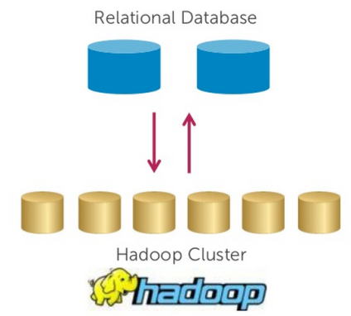
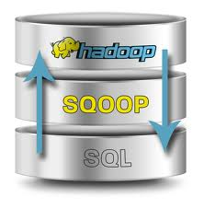
Apache Sqoop
Sqoop is a tool designed to transfer data between Hadoop and relational database servers.
It is used to import data from relational databases such as MySQL, Oracle to Hadoop HDFS, and export from Hadoop file system to relational databases.

Slide 37

Apache Flume
Ingesting data is an important part of our Hadoop Ecosystem.
The Flume is a service which helps in ingesting unstructured and semi-structured data into HDFS.
It gives us a solution which is reliable and distributed and helps us in collecting, aggregating and moving large amount of data sets.
It helps us to ingest online streaming data from various sources like network traffic, social media, email messages, log files etc. in HDFS.

Slide 38
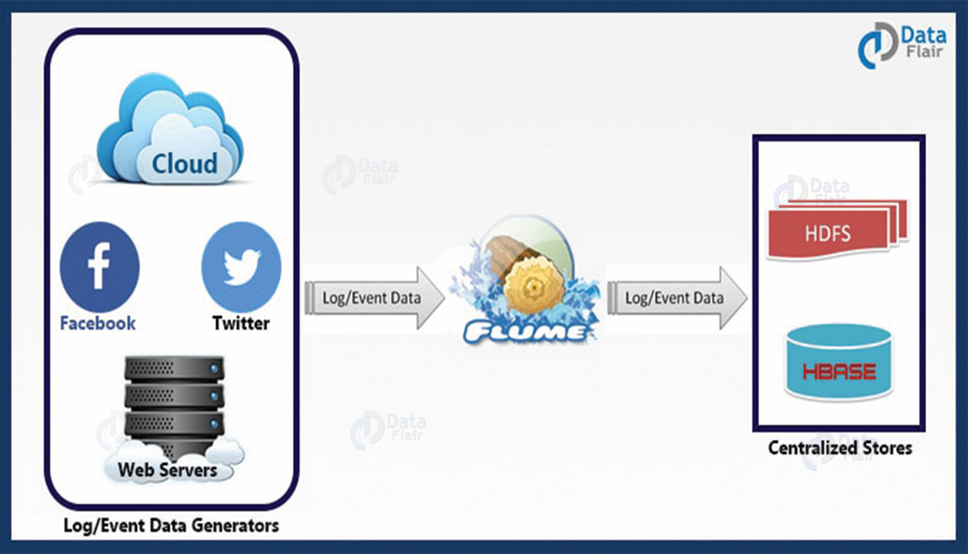
Apache Flume – How does it work?
There is a Flume agent which ingests the streaming data from various data sources to HDFS.
From the diagram, you can easily understand that the web server indicates the data source.
Twitter is among one of the famous sources for streaming data.
Notes:
‹#›

Slide 39
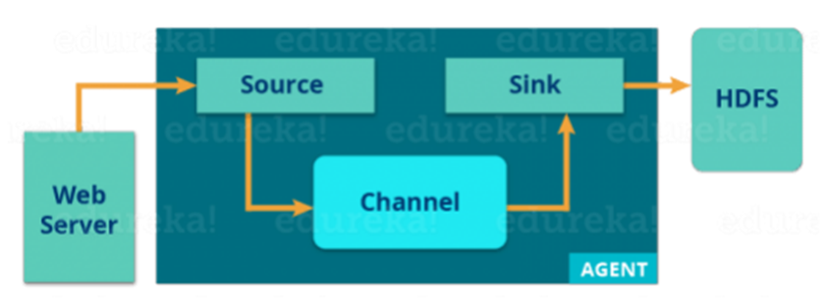
Apache Flume – How does it work?
The flume agent has 3 components: source, sink and channel.
Source: it accepts the data from the incoming streamline and stores the data in the channel.
Channel: it acts as the local storage or the primary storage. A Channel is a temporary storage between the source of data and persistent data in the HDFS.
Sink: Then, our last component i.e. Sink, collects the data from the channel and commits or writes the data in the HDFS permanently.
Notes:
‹#›

Slide 40

Hadoop User Experience (Hue)
Hue is an open-source Web interface that supports Apache Hadoop and its ecosystem.
It is license developed by cloudera.
Hue aggregates the most common Apache Hadoop components into a single interface and targets the user experience.
Its main goal is to have the users "just use" Hadoop without worrying about the underlying complexity or using a command line.

Slide 41

Oozie
Oozie has been just like a scheduler.
It schedules Hadoop jobs and binds them together as one logical work.
There are two kinds of Oozie jobs:
Oozie workflow: These are sequential set of actions to be executed. You can assume it as a relay race. Where each athlete waits for the last one to complete his part.
Oozie Coordinator:
These are the Oozie jobs which are triggered when the data is made available to it.
Think of this as the response-stimuli system in our body. In the same manner as we respond to an external stimulus, an Oozie coordinator responds to the availability of data and it rests otherwise.

Slide 42

ZooKeeper
Apache Zookeeper coordinates with various services in a distributed environment.
The services earlier had many problems with interactions like common configuration while synchronizing data. Even if the services are configured, changes in the configurations of the services
Zookeeper performs synchronization, configuration maintenance, grouping and naming.

Slide 43
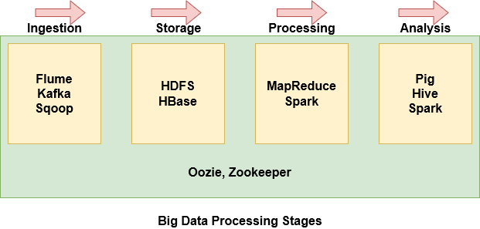
Big Data Processing Stages

Slide 44
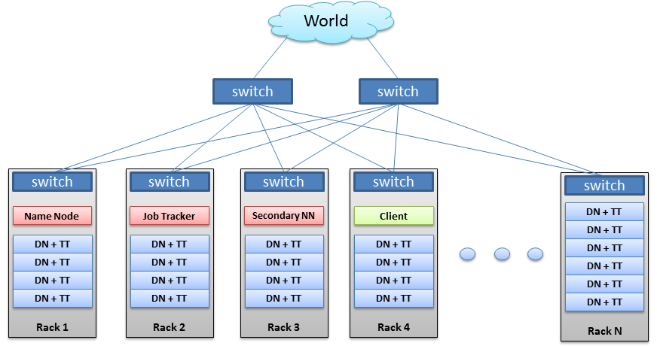
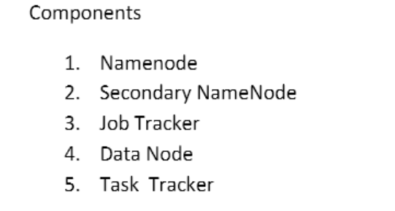
Hadoop Architecture 1.X

Slide 45
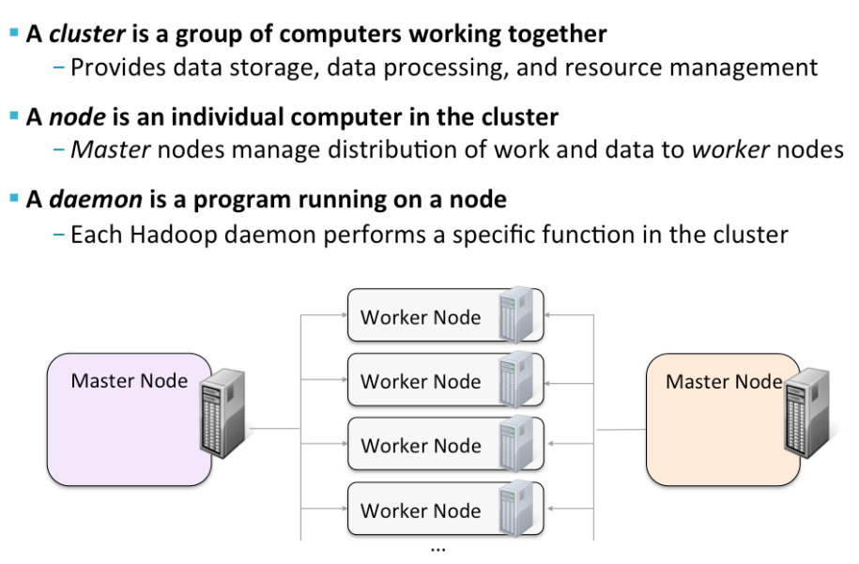
Hadoop cluster terminology

Slide 46
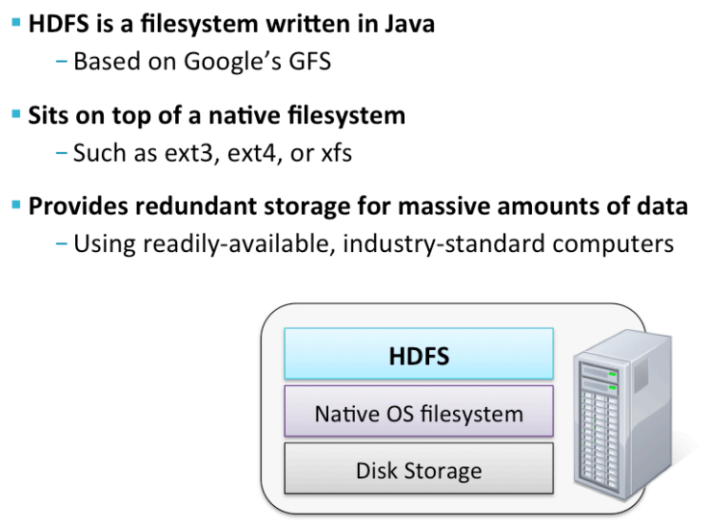
Hadoop cluster terminology

Slide 47
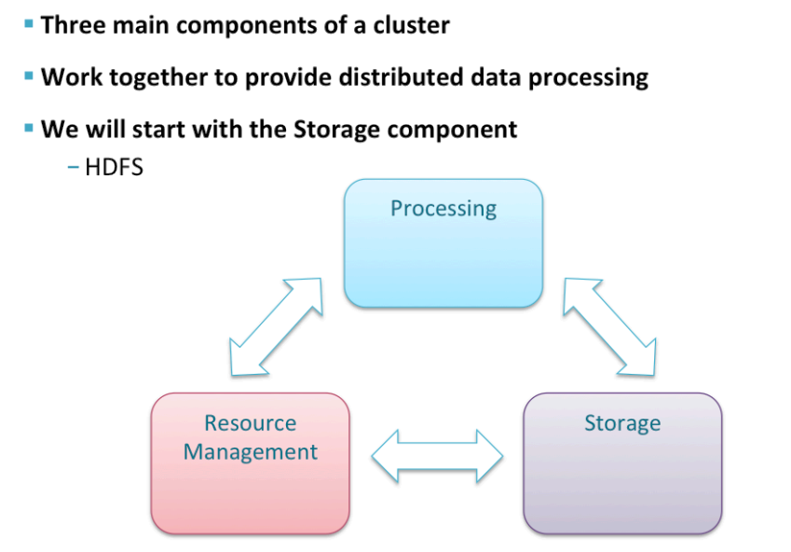
Cluster components

Slide 48
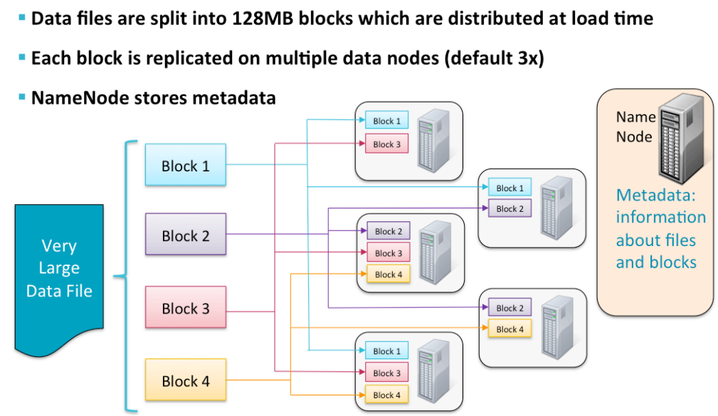
How files are stored?

Slide 49
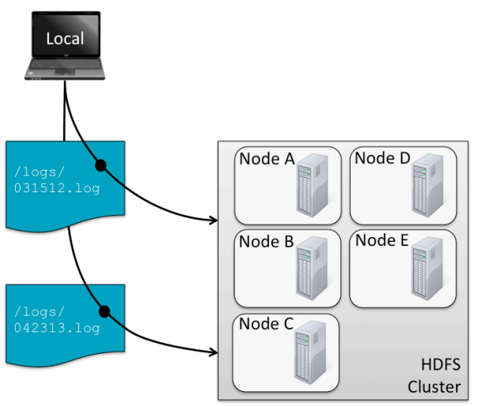
Storing & Retrieving files

Slide 50
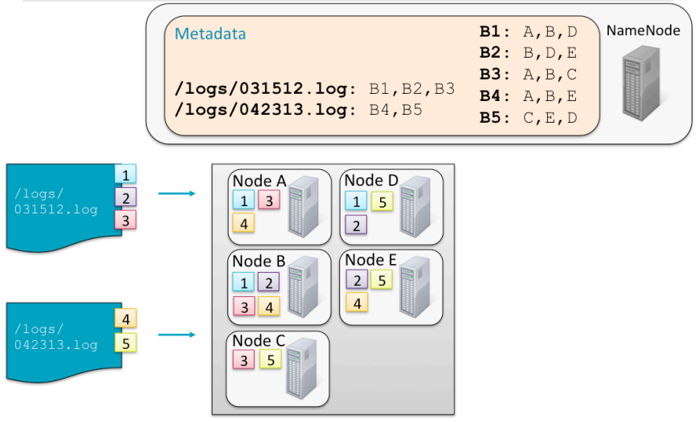
Storing & Retrieving files

Slide 51
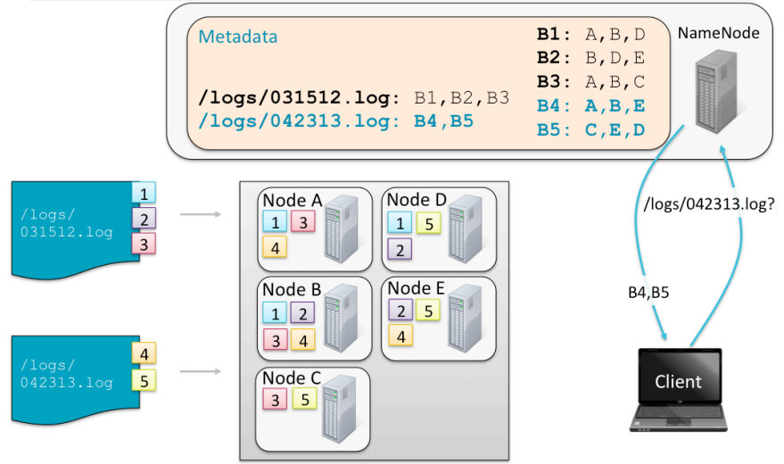
Storing & Retrieving files

Slide 52
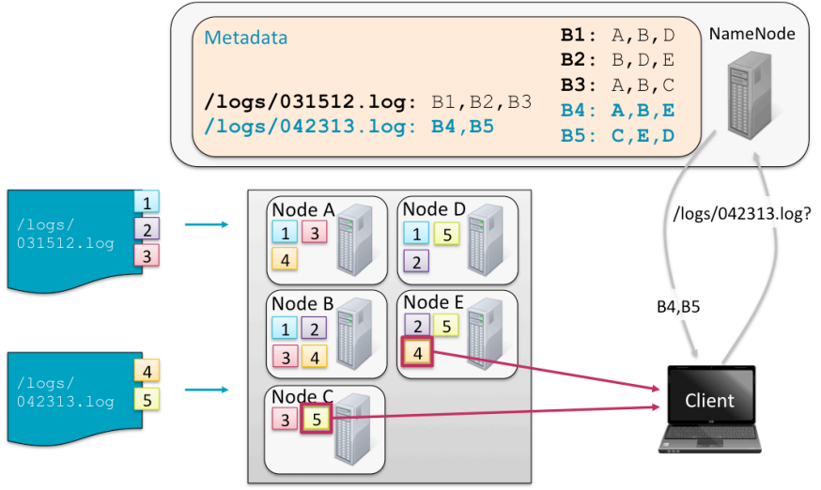
Storing & Retrieving files

Slide 53
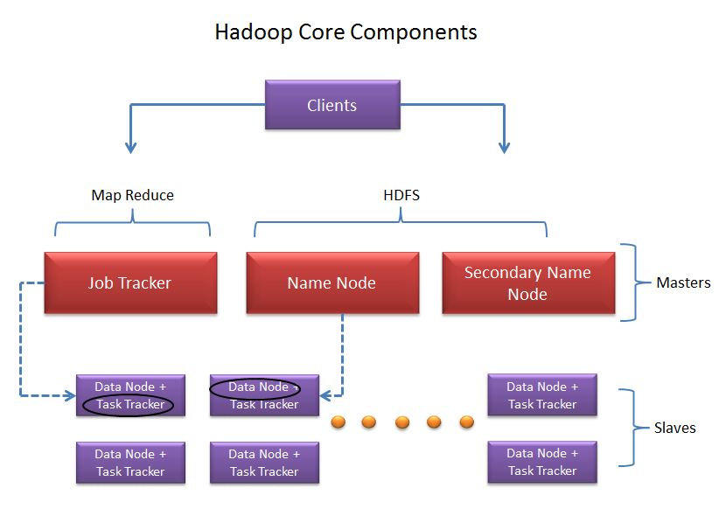
Hadoop Core components

Slide 54
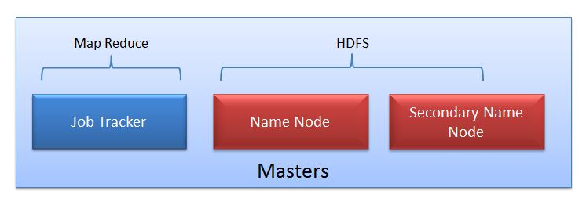
Master
The Masters consists of 3 components:
Name Node
Secondary Node
JobTracker.

Slide 55
Master Node: NameNode
It is the master daemon that maintains and manages the Data Nodes (slave nodes).
It records the metadata of all the files stored in the cluster, e.g.
The size of the files
Number of blocks
Location of all blocks stored, in which nodes they are stored
Permissions
Hierarchy etc.
It records each and every change that takes place to the file system metadata.
This Information is stored in main memory as well as disk for persistence storage.

Slide 56
NameMaster Node: NameNode
Fs image: Fs image stands for File System image. It contains the complete namespace of the Hadoop file system since the NameNode creation.
Edit log: It contains all the recent changes performed to the file system namespace to the most recent Fs image.
For example, if a file is deleted in HDFS, the Name Node will immediately record this in the EditLog.
If the Data Node fails, the Name Node chooses new Data Nodes for new replicas.

Slide 57
Master Node: Secondary Name Node
It is not a backup Name node.
Name node stores metadata in main memory as well as in disks for persistent storage.
The job of Secondary Node is to contact NameNode in a periodic manner after certain time interval(by default 1 hour).

Slide 58
Master Node: Secondary Name Node
What secondary node does is it contacts NameNode in an hour and pulls copy of metadata information out of NameNode. It shuffle and merge this information into clean file folder and sent to back again to NameNode, while keeping a copy for itself.
As the Name Node is the single point of failure in HDFS, if Name Node fails entire HDFS file system is lost.
So in order to overcome this, Hadoop implemented Secondary NameNode whose main function is to store a copy of Fs Image file and edits log file.

Slide 59
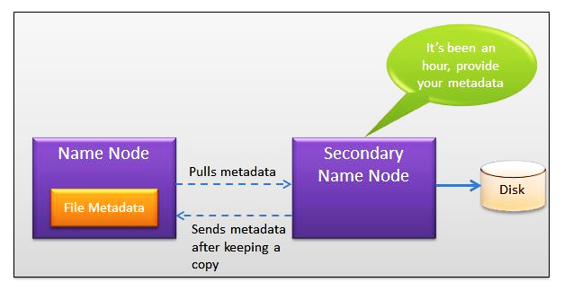
Master Node: Secondary Name Node

Slide 60
Slave Node
Slave nodes are the majority of machines in Hadoop Cluster and are responsible to:
Store the data
Process the computation

Slide 61
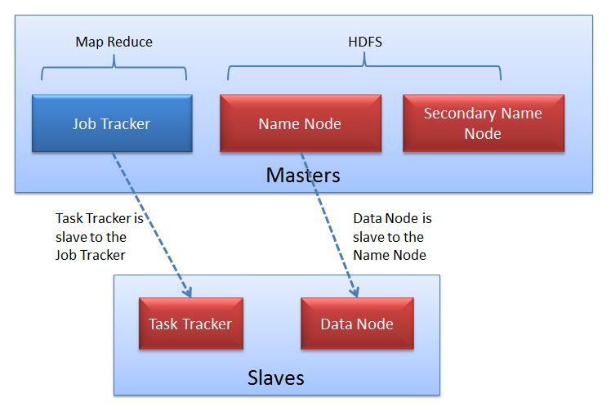

Slide 62
Slave Nodes: Data Nodes
These are slave daemons which runs on each slave machine.
Each slave machine is Commodity hardware.
It is a non expensive system
Hadoop can be installed on any commodity hardware.
We don't need super computers or high-end hardware to work on Hadoop.
Commodity hardware includes RAM because there will be some services which will be running on RAM. Hadoop is Economical
The actual data is stored on Data Nodes.

Slide 63
Slave Nodes: Data Nodes
They are responsible for serving read and write requests from the clients.
They are also responsible for creating blocks, deleting blocks and replicating the same based on the decisions taken by the Name Node.
Name node and data node do communicate using Heartbeat.
Therefore Heartbeat is the signal that is sent by the datanode to the namenode after the regular interval to time to indicate its presence, i.e. to indicate that it is alive.
This frequency is set to be 3 sec.
If after a certain time of heartbeat Name Node does not receive any response from Data Node, then that particular Data Node used to be declared as dead.

Slide 64
Master Node: Job Tracker
JobTracker coordinates the parallel processing of data using MapReduce.
MapReduce Engine: JobTracker & TaskTracker
JobTracker splits up data into smaller tasks(“Map”) and sends it to the TaskTracker process in each node
TaskTracker reports back to the JobTracker node and reports on job progress, sends data (“Reduce”) or requests new jobs

Slide 65
Data Processing using Mapreduce
MAPREDUCE is a software framework and programming model used for processing huge amounts of data.
MapReduce program work in two phases.
Map and Reduce.
Map tasks deal with splitting and mapping of data.
Reduce tasks shuffle and reduce the data.
Hadoop is capable of running Map Reduce programs written in various languages: Java, Ruby, Python, and C++.
MapReduce programs are parallel in nature, thus are very useful for performing large-scale data analysis using multiple machines in the cluster.

Slide 66
Data Processing using Mapreduce
Four steps of Mapreduce
Splitting
Mapping
Shuffling
Reducing

Slide 67
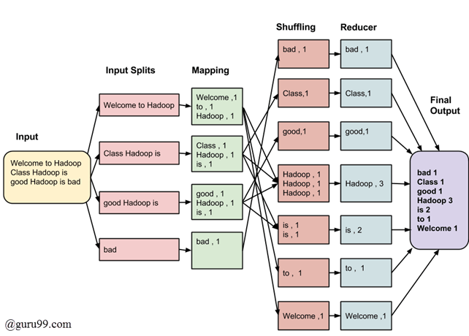
Data Processing using Mapreduce
Consider the following input data for Map Reduce Word Count Program.

Slide 68
Data Processing using Mapreduce
Map stage : To process the input data.
Input Splits: An input (File stored in HDFS) to a is divided into fixed-size pieces called input splits. This chunk of the input is given to mapper function line by line.
Mapping : Map takes a chunk of data and converts it into another set of data, where individual elements are broken down into tuples (key/value pairs).
Ex: Job of mapping phase is to count a number of occurrences of each word from input splits and prepare a list in the form of <word, frequency>

Slide 69
Data Processing using Mapreduce
Reduce : To process the data coming from Mapper
Shuffling: This phase consumes the output of Mapping phase. Its task is to consolidate the relevant records from Mapping phase output. In our example, the same words are clubbed together along with their respective frequency.
Reducing: In this phase, output values from the Shuffling phase are aggregated. This phase combines values from Shuffling phase and returns a single output value. In short, this phase summarizes the complete dataset.

Slide 70
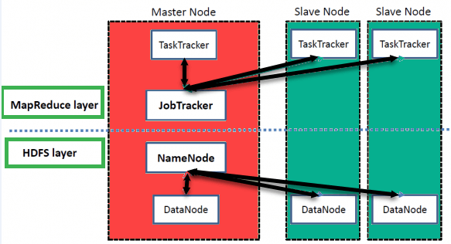
Data Processing using Mapreduce
Execution of Map and Reduce tasks, both is controlled by two types of entities.
Job tracker
Task tracker
Job tracker: Resides on Name node, acts like a master (responsible for scheduling job runs, managing computational resources and complete execution of submitted job)
Multiple Task Trackers: Reside in data nodes, acts like slaves, each of them performing the job.

Slide 71
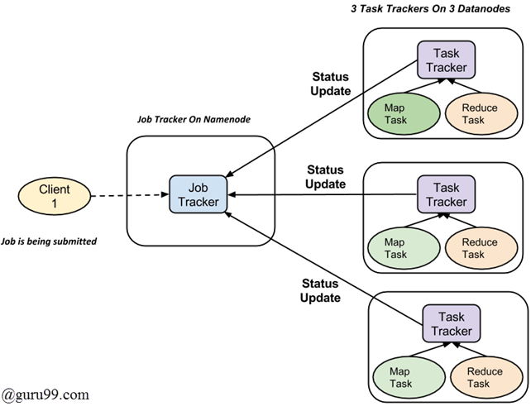
Data Processing using Mapreduce

Slide 72
Data Processing using Mapreduce
A job is divided into multiple tasks which are then run onto multiple data nodes in a cluster.
It is the responsibility of job tracker to coordinate the activity by scheduling tasks to run on different data nodes.
Execution of individual task is then to look after by task tracker, which resides on every data node executing part of the job.
Task tracker's responsibility is to send the progress report to the job tracker.
In addition, task tracker periodically sends 'heart beat' signal to the Job tracker so as to notify it of the current state of the system.
Thus job tracker keeps track of the overall progress of each job.
In the event of task failure, the job tracker can reschedule it on a different task tracker depending upon where the data is present.

Slide 73
Hadoop 1.X Limitations
There is a single NameNode which is thus the single point of failure.
It works with only MapReduce.
MapReduce work as resource manager.
It is only suitable for Batch Processing of Huge amount of Data, which is already in Hadoop System.
It is not suitable for Real-time Data Processing.
It is not suitable for Data Streaming.
It supports upto 4000 Nodes per Cluster.

Slide 74
Hadoop 2.X & Hadoop 3.X
To overcome issues of Hadoop 1.X, YARN was introduced in Hadoop version 2.0 in the year 2012 by Yahoo and Hortonworks.
The basic idea behind YARN is to relieve MapReduce by taking over the responsibility of Resource Management and Job Scheduling.
YARN started to give Hadoop the ability to run non-MapReduce jobs within the Hadoop framework.

Slide 75
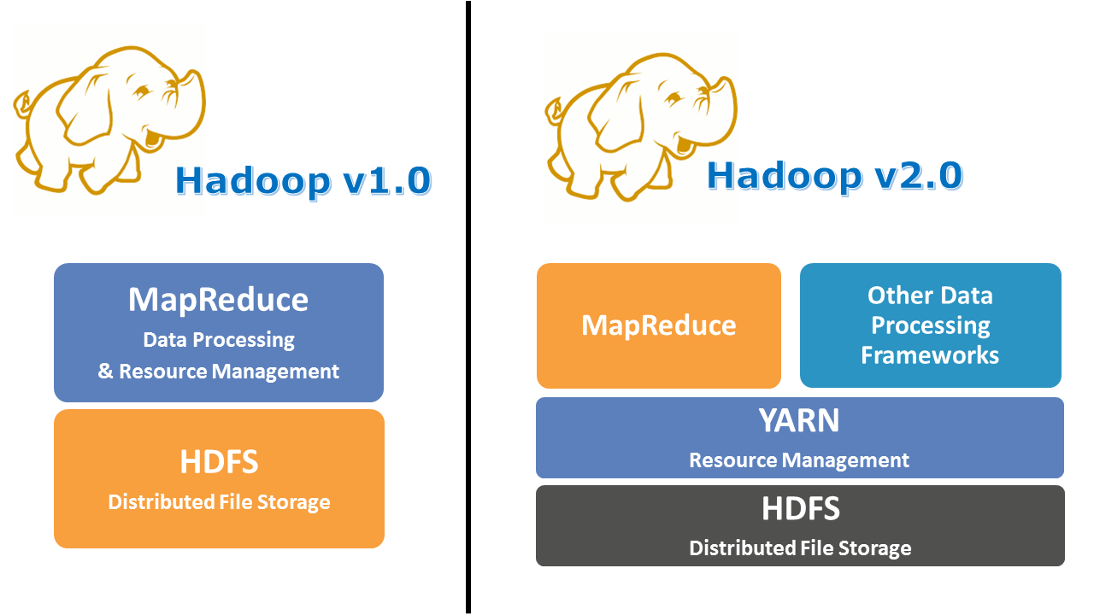
Apache Yarn

Slide 76
Apache Yarn
“Yet Another Resource Negotiator” is the resource management layer of Hadoop.
The Yarn was introduced in Hadoop 2.x.
Yarn allows different data processing engines like graph processing, interactive processing, stream processing as well as batch processing to run and process data stored in HDFS.
Apart from resource management, Yarn also does job Scheduling.

Slide 77
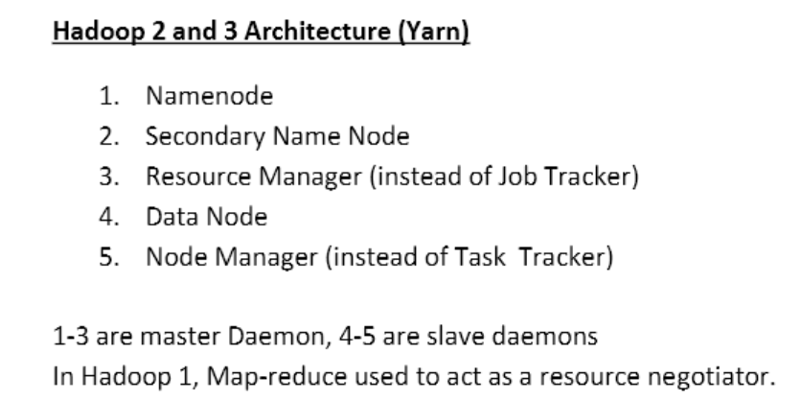
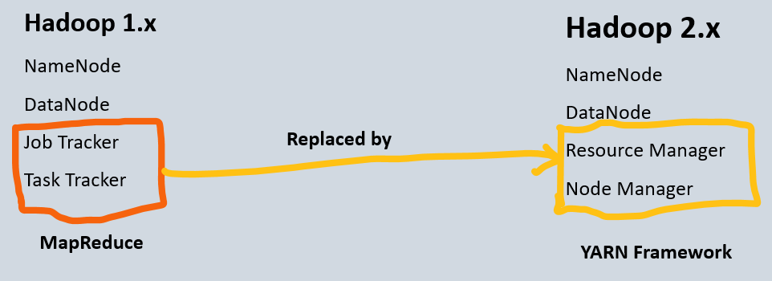
Hadoop 2.x

Slide 78
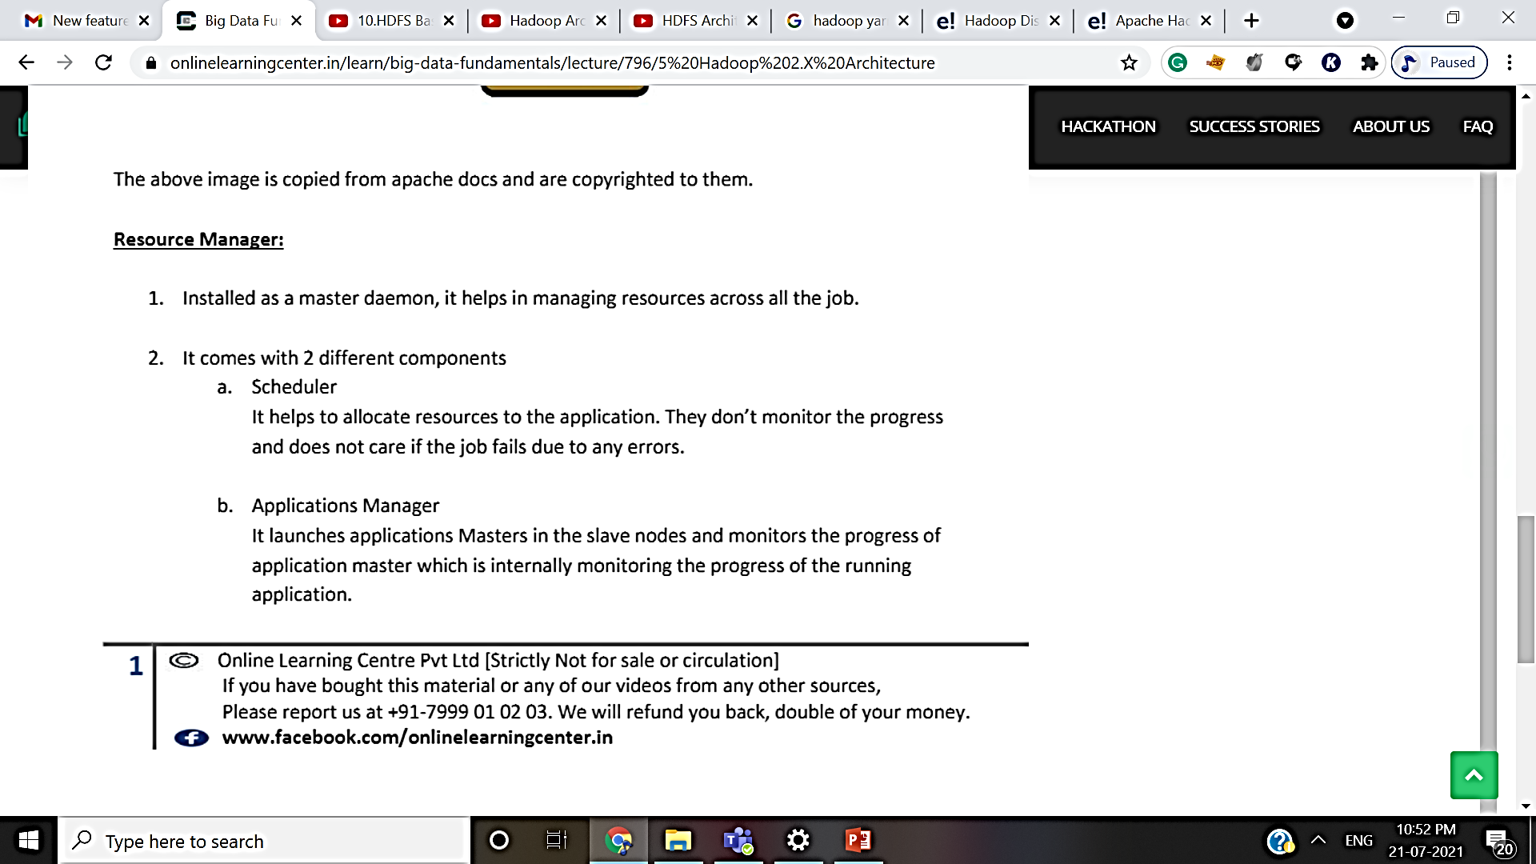
Hadoop 2.x

Slide 79
Resource Manager Components
a) Scheduler
The scheduler is responsible for allocating the resources to the running application.
The scheduler is pure scheduler it means that it performs no monitoring , no tracking for the application and even doesn’t guarantees about restarting failed tasks either due to application failure or hardware failures.
b) Application Manager
It manages running Application Masters in the cluster, i.e.,
it is responsible for starting application masters and for monitoring and restarting them on different nodes in case of failures.

Slide 80
Node Manager
It is the slave daemon of Yarn.
Manage the user process on that machine.
Yarn Node Manager also tracks the health of the node on which it is running.
A shuffle is a typical auxiliary service by the NMs for MapReduce applications on YARN.

Slide 81
Application Master
Manages the user job lifecycle and resource needs of individual applications.
It works along with the Node Manager and monitors the execution of tasks(one per application).

Slide 82

Container

Slide 83
Difference between Hadoop 1 and Hadoop 2
Hadoop 1 | Hadoop 2
Map Reduce which works as Resource Management as well as Data Processing. Due to this workload on Map Reduce, it will affect the performance. | YARN which works as Resource Management. It basically allocates the resources and keeps all the things going on.
Supports MapReduce processing model in its architecture and it does not support non MapReduce tools. | Allows to work in MapReduce model as well as other distributed computing models like Spark, Hama, Giraph, Message Passing Interface) MPI & HBase coprocessors.
Daemons: Namenode Datanode Secondary Namenode Job Tracker Task Tracker | Daemons: Namenode Datanode Secondary Namenode Resource Manager Node Manager
Single master and multiple slaves. Suppose if master node got crashed then irrespective of your best slave nodes, your cluster will be destroyed. | Multiple masters (i.e active namenodes and standby namenodes) and multiple slaves. If here master node got crashed then standby master node will take over it.
Scalability: limited to 4000 nodes per cluster | Scalability: scalable up to 10000 nodes per cluster.

Slide 84
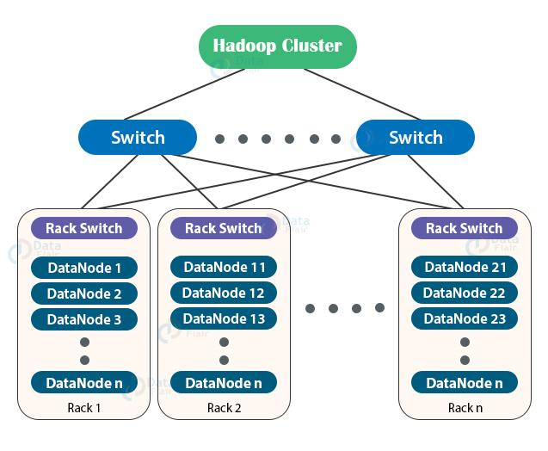
Rack Awareness
The Rack is the collection of around 40-50 DataNodes connected using the same network switch.
If the network goes down, the whole rack will be unavailable. A large Hadoop cluster is deployed in multiple racks.

Slide 85
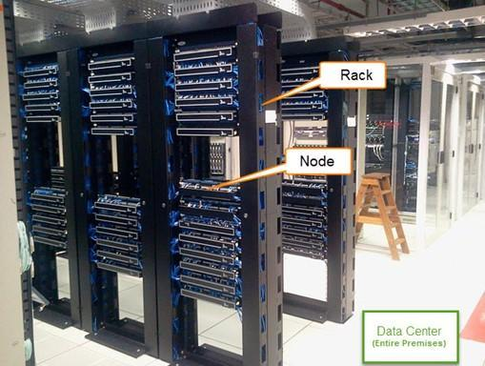
Data Centre
Communication between the Data Nodes on the same rack is more efficient as compared to the communication between Data Nodes residing on different racks.

Slide 86
Rack Awareness
To reduce the network traffic during file read/write, NameNode chooses the closest DataNode for serving the client read/write request.
NameNode maintains rack ids of each DataNode to achieve this rack information.
This concept of choosing the closest Data Node based on the rack information is known as Rack Awareness.

Slide 87
Rack Awareness
The reasons for the Rack Awareness in Hadoop are:
To reduce the network traffic while file read/write, which improves the cluster performance.
To achieve fault tolerance, even when the rack fails.
Achieve high availability of data so that data is available even in unfavorable conditions.
To reduce the latency, that is, to make the file read/write operations done with lower delay.

Slide 88
Rack Awareness Algorithm
To ensure that all the replicas of a block are not stored on the same rack or a single rack, NameNode follows a rack awareness algorithm to store replicas and provide latency and fault tolerance.
Not more than one replica be placed on one node.
Not more than two replicas are placed on the same rack.

Slide 89
Rack Awareness Algorithm
Suppose if the replication factor is 3, then according to the rack awareness algorithm:
The first replica will get stored on the local rack.
The second replica will get stored on the other Data Node in the same rack.
The third replica will get stored on a different rack, near to first rack, so as to have higher bandwidth and low latency.

Slide 90
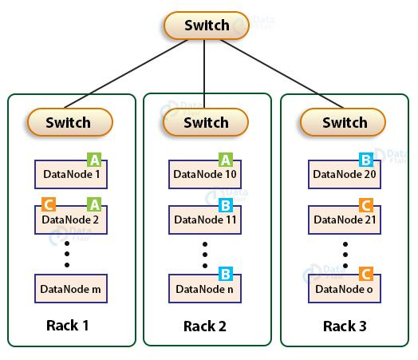
300MB = A(128)+B(128)+C (44)… 3 blocks
A
B
C

Slide 91
Advantage of Rack Awareness Algorithm
Preventing data loss against rack failure
Minimize the cost of write and maximize the read speed
Maximize network bandwidth and low latency

Slide 92
University Question
Q.1 Give Hadoop Ecosystem and briefly explain its component [Comp-SH16] [10marks]
Q.2 Explain HDFS architecture with diagram [ IT-FH16][10 marks]

Slide 93
Important Questions
Define the term 1. name node 2. data node 3. job tracker 4 .task tracker
What is Hadoop ? Need of Hadoop
What are the core component of Hadoop framework
What is HDFS and what are its features?
If replication cause data redundancy ,then why it is pursued in HDFS?
Hadoop Installation steps with demo.
https://www.simplilearn.com/tutorials/hadoop-tutorial/hadoop-ecosystem

